Slide 1


Secure Destruction
Cap Metro Focus Group Meeting
October 26, 2015

Slide 2
Agenda
Secure Destruction Service Overview and Update
Mailer Participation and Enrollment Requirements
Next Steps
2
Notes:
Has anyone here done secure destruction.

Slide 3


Each year USPS® returns over 1.2 billion pieces of Undeliverable-As-Addressed (UAA) First-Class Mail® to mailers
Large mailers send mail that is processed at USPS® facilities prior to being sent out for delivery.
Secure Destruction eliminates UAA Return to Sender mail at the USPS® facility.
Secure Destruction Service
Secure Destruction was created in response to mailers asking to reduce handling costs for “Return to Sender” mail with Privacy Protected Information (PPI)
Applies only to letter-sized First-Class Mail®
Performed by USPS® employees in USPS® facilities
An opt-in service for mailers provided at no additional fee

Slide 4
Secure Destruction may be of interest to mailers who face the risk of liabilities if they don’t properly and securely destroy PPI
Protected by…
Protected by…
Health Insurance Portability and Accountability Act of 1996
Financial Records
Financial Services Modernization Act of 1999
Health Records
Consumer Records
Target Types of PPI
Protected by…
State Security Breach Notification Laws
Protected by...
Student Records
Family Educational Rights and Privacy Act of 1974
Federal Government Records
Credit Card Records
Protected by…
Governed by…
Privacy Act of 1974
Payment Card Industry Data Security Standard

Slide 5
Industries that will benefit most from using the Secure Destruction Service include:
Financial Services |  | Banking Credit Card Providers Investment Firms
Service Providers |  | Health Care Insurance Legal | Telecommunications Utilities
Government |  | Federal Government Agencies State Government Agencies Government Contractors
Education |  | Public Institutions Private Institutions

Slide 6




What additional in-house quality controls are used to ensure undeliverable SD mail is securely destroyed ?
Mail Verification - All SD mail generated undergoes individual mailpiece verification prior to destruction
Standard Handling Procedures - Mail that is not eligible or that could not be processed is handled per standard procedures
Postal Inspection Service - Periodic security assessments of Secure Destruction processes and procedures are conducted
Office of the Inspector General - Per Title 18, United States Code, investigations will occur for any allegations of mail theft by individuals and entities under contract with the Postal Service
The Postal Service has a long history of protecting the sanctity of the mail.

Slide 7


Securely destroying mail within USPS® processing facilities provides three types of benefits:
Environmental - Reduces the carbon footprint of UAA mail through recycling and eliminating unnecessary reverse logistics associated with returning mailpieces to the sender
Economic - Reduces the costs for mailers for handling and destroying RTS mail in-house or through third party contactors
Security - Strengthens mailers’ information security programs, processes, and procedures
Notes:
One company saved $.17 each. No need to dael with the hassel of the regulations

Slide 8
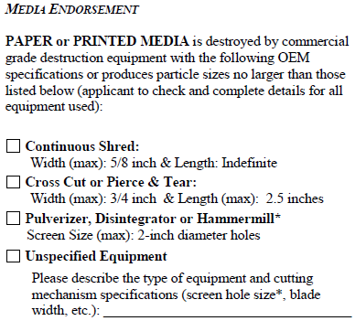
Secure Destruction shreds to a smaller size than the NAID standard
USPS® uses industrial cross-cut shredders
NAID maximum shred size:
  Width: 0.75 inch
  Length 2.5 inches
  Surface Area: 1210 mm²
USPS® maximum shred size:
  Width: 0.24 inch (6mm)
  Length: 1 inch (25.4mm)
  Surface Area: 152 mm²
Current level of destruction exceeds the level required to meet the NAID standard
Excerpt from the NAID
Auditing Criteria June 2014

Slide 9
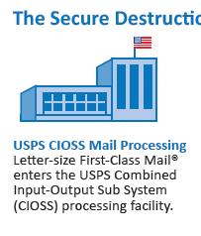
International Standard DIN 66399 has seven levels for paper data destruction
P-Level 1: General Data Surface Area: ≤ to 2000mm² or strip width: ≤ 12mm (unlimited length)
P-Level 2: Internal Data Surface Area: ≤ 800mm² or
Strip width: ≤ 6mm (unlimited length)
P-Level 3: Sensitive & Confidential Data
Surface Area: ≤ 320mm² or Strip width: ≤ 2mm (unlimited length)
P-Level 4: Particularly Sensitive & Confidential Data
Surface Area: ≤ 160mm² and
Strip width: ≤ 6mm
P-Level 5: Secret Data Surface Area: ≤ 30mm² and strip width: ≤ 2mm
P-Level 6: Highly Secret Data Surface Area: ≤ 10mm² and strip width: ≤ 1mm
P-Level 7: Top Secret Data Surface Area: ≤ 5mm² and strip width: ≤ 1mm

Slide 10
USPS Secure Destruction shred size is more stringent than NAID, DIN, and common US industry practice for documents with sensitive and/or confidential information
NAID
Surface Area: 1210 mm²
Dimension: 0.75” x 2.5”
DIN Standards Level 3
Surface Area: ≤ 320 mm² or
Strip width: ≤ 2mm
DIN Standards Level 4
Surface Area: ≤ 160 mm² and
Strip width: ≤ 6mm (0.24”)
Common Industry Practice
Surface Area: 252 mm²
Dimension: 0.63” x 0.63”
(5/8” x 5/8”)
USPS SD Standard
Surface Area: 152 mm²
Dimension: 0.24” x 1”

Slide 11
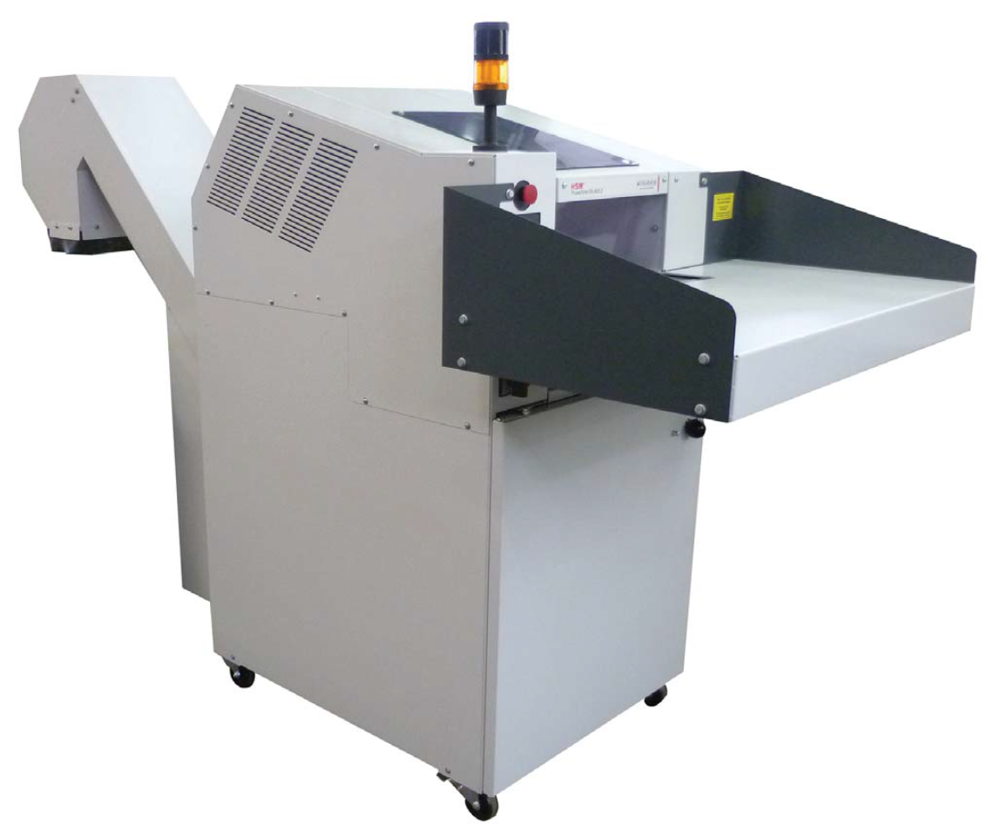
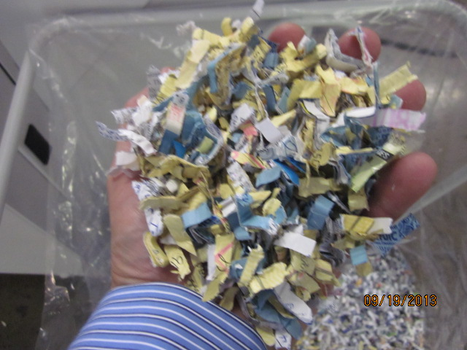
A USPS Secure Destruction industrial cross-cut shredder and paper shred size is pictured below

Slide 12
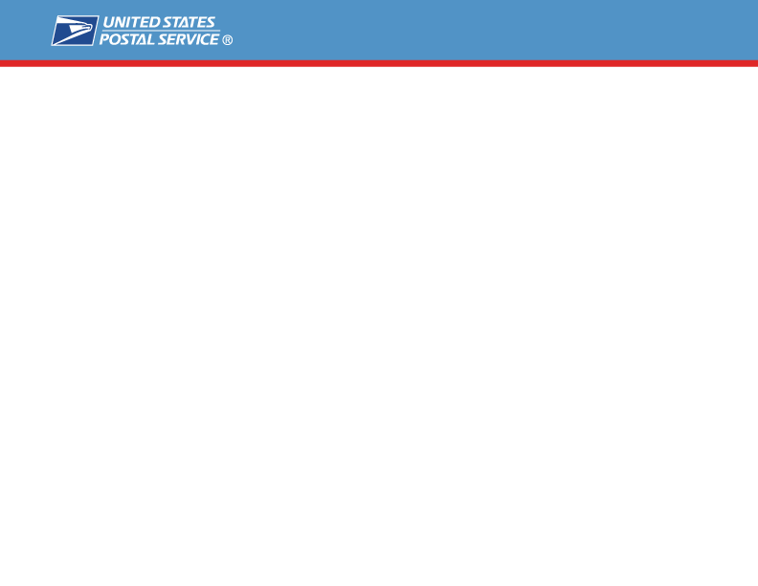

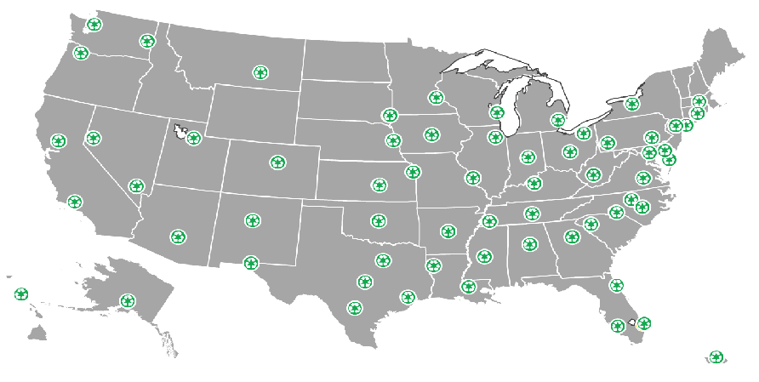


“The Secure Destruction Mail Service Program was launched nationwide at all 61 CIOSS plants across the country on November 18th, 2014.”
SD CIOSS Plant Locations

Slide 13
Secure Destruction CIOSS Plant Locations ( 61 Nationwide)*
Area | SD Plants
Capital Metro | Baltimore MD | North Metro GA
 | Charlotte NC | Raleigh NC
 | Greensboro NC | Richmond VA
 | Greenville SC | Southern MD
Eastern | Charleston WV | Memphis TN
 | Cleveland OH | Nashville TN
 | Columbus OH | Pittsburgh PA
 | Lancaster PA | Rochester NY
 | Louisville KY
Great Lakes | Detroit MI | Palatine IL
 | Indianapolis IN | St Louis MO
 | Milwaukee WI
Northeast | Central MA | Morgan NY #1
 | Hartford CT | San Juan PR
 | Northern NJ
Pacific | Honolulu HI | Sacramento CA
 | Industry CA
Area | SD Plants
Southern | Austin TX | Little Rock AR
 | Baton Rouge LA | North Houston TX
 | Birmingham AL | North Texas
 | El Paso TX | Oklahoma City OK
 | Fort Myers FL | San Antonio TX
 | Jackson MS | Shreveport LA
 | Jacksonville FL | West Palm FL
Western | Albuquerque NM | Phoenix AZ
 | Anchorage AK | Portland OR
 | Billings MT | Reno NV
 | Denver CO | Salt Lake City UT
 | Des Moines IA | Seattle WA
 | Kansas City MO | Sioux Falls SD
 | Las Vegas NV | Spokane WA
 | Minneapolis MN | Wichita KS
 | Omaha NE
* Note: Initial pilot sites shown in bold text

Slide 14
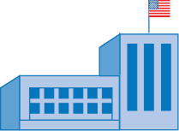







Regardless of where an SD mail piece originates, all UAA SD mail will be processed at one of the 61 CIOSS plants
1st Class IMb SD Letter Mail
CIOSS Processing Plant
(61 plants Nationwide)
All UAA SD Mail (Intercept)
UAA SD Mail (CIF and RTS)
Business Mail Entry Unit
(Anywhere Nationwide)
Deliverable Mail
Mail Address Location

Slide 15

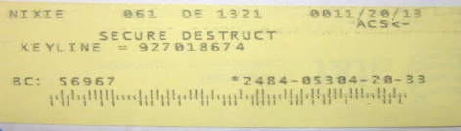
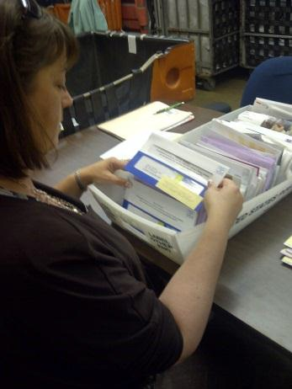
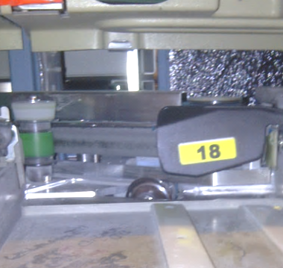


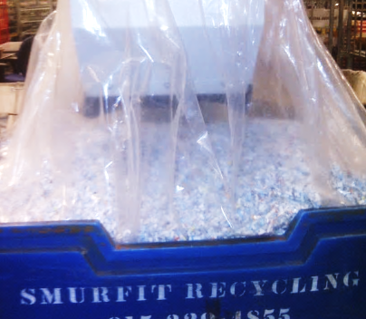
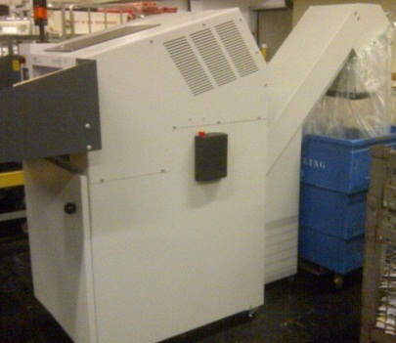
Existing and new equipment will be used to complete the process
1
2
3
USPS® CIOSS Undeliverable Mail Processing (PARS)
Letter-size First-Class Mail® enters the USPS® Combined Input-Output Sub System (CIOSS) processing facility.
Label and Sort Mailpieces
UAA RTS mail is labeled and sorted for Secure Destruction.
Verify Mailpieces
All SD mail is verified by USPS® employees prior to destruction.
5
4
Recycle Shredded Paper
USPS® facilities recycle shredded SD mail.
Shred Mailpieces
All verified SD mail is fed into an industrial cross-cut shredder at the USPS® facility.
Notes:
Secure Destruction is a part of the USPS® BlueEarth sustainability initiatives. The service securely shreds and recycles letter-size pieces of Undeliverable-As-Addressed (UAA) First-Class Mail® with personal protected information that would otherwise be returned to the sender. Secure Destruction is an opt-in service that operates under the protection and supervision of the United States Postal Service.
STID is used (specific STID)

Slide 16
USPS mail verification staff follow a detailed process to evaluate that all mailpieces are properly marked for secure destruction
1
Verify that the yellow label says “Secure Destruct”.
4
If there is also a first name on the label, verify that it matches the first name on the letter.
Verify that the mail class printed on the label matches the mail class on the letter. Note all SD mail should have a “1” on the SD label to indicate first class mail
2
5
Verify that the mailpiece has a mailer applied IMB.
If there is a surname on the label, verify that it matches the last name on the letter.
Verify that “ACS<-” appears on the yellow label in the upper right.
3
6
Notes:
Secure Destruction is a part of the USPS® BlueEarth sustainability initiatives. The service securely shreds and recycles letter-size pieces of Undeliverable-As-Addressed (UAA) First-Class Mail® with personal protected information that would otherwise be returned to the sender. Secure Destruction is an opt-in service that operates under the protection and supervision of the United States Postal Service.

Slide 17

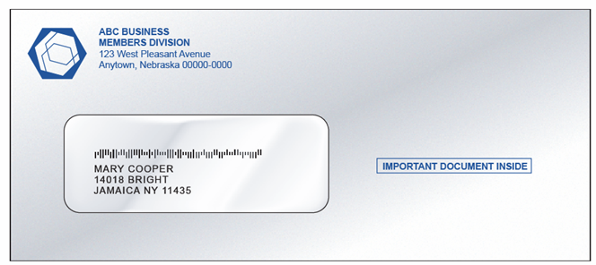
Secure Destruction participation requirements include:
Mail must be First-Class Mail®
Mail must bear Intelligent Mail® barcode (IMbTM) containing a Secure Destruction Service Type Identifier (STID)
Barcode must be readable
Mailer must be enrolled in Secure Destruction Mail Service Program
A printed ancillary service endorsement is optional for First-Class Mail® when using the IMb™
Notes:
17
Currently, there is a segment of the mailing industry that cannot or will not allow the U.S. Postal Service to dispose of their UAA mailpieces because of the risk associated with exposing sensitive information contained in the mailing. In response to these concerns, the USPS is exploring the possibility of offering a Secured method of disposing of mail.
Under this program, mailpieces will be rendered unreadable prior to disposal using industry standard destruction methods. Typically this is achieved by shredding the mailpiece, making it impractical to retrieve any information from the disposed mailpiece.
To participate, mailers will use a Service Type ID established for Secure Destruction. Then UAA mail will be routed to the Secure Destruction process.
(Click)

Slide 18
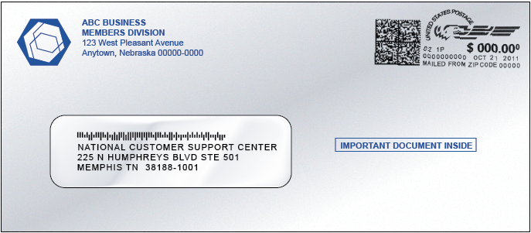
Secure Destruction can only occur when the Intelligent Mail® Barcode is readable
If the barcode cannot be read and there is no printed endorsement, the mail will be treated as unendorsed
The default treatment for unendorsed First-Class Mail® is to be forwarded or returned with no additional postage paid and no separate address correction notice
If “Change Service Requested” is printed and the IMb™ cannot be read, First-Class Mail® will be returned to sender.
Ineligible mail pieces (e.g. flats) with an SD STID will be handled as ASR-Option 2 (i.e. forwarded if possible or returned to sender)..

Slide 19
Enrollment and Registration Requirements - There are five steps to register for Secure Destruction Service:
1
Use of IMbTM for letter-sized First-Class Mail® is required
Full-Service or Basic IMbTM used on letter-sized First-Class Mail ® is allowed
Information and Resources regarding the IMbTM can be found at: https://ribbs.usps.gov/index.cfm?page=intellmailmailpieces
2
An ACS account is required to receive Secure Destruction Notices
You may use an existing ACSTM account: SingleSource ACSTM, OneCode ACS®, or Traditional ACSTM
If you do not already have an ACS account, complete and submit the ACS Enrollment Form at: https://ribbs.usps.gov/acs/documents/tech_guides/eACS001.PDF
3
Use Existing or Register for an Electronic Product Fulfillment Account
If you already have an ACS account with EPF access, then you may skip this step.
If not, go to http://epf.usps.gov for the EPF Web Access Request Form
4
Enroll in the Secure Destruction program
The form is available in the Secure Destruction eNotification guide, or from: http://ribbs.usps.gov/forms/documents/secure_destruction/SDACS001.pdf

Slide 20
5
Determine which Secure Destruction STID you will use in the IMbTM
Information is available in the Secure Destruction Electronic Notification documentation.
 | Basic Non-Auto Service |  | Full Service
Address Correction Option | Without IMb™ Tracing | With IMb™ Tracing | Without IMb™ Tracing | With IMb™ Tracing
Full-Service ACS™ – Change Service Requested Opt 1 w/Secure Destruction |  |  | Available for Qualified Full Service IMb™ | Available for Qualified Full Service IMb™
Full-Service ACS™ – Change Service Requested Opt 2 w/Secure Destruction |  |  | Available for Qualified Full Service IMb™ | Available for Qualified Full Service IMb™
One Code ACS® – Change Service Requested Opt 1 w/Secure Destruction | Available for OneCode ACS® Participants | Available for OneCode ACS® Participants
One Code ACS® – Change Service Requested Opt 2 w/Secure Destruction | Available for OneCode ACS® Participants | Available for OneCode ACS® Participants
Traditional ACS™ Format – Change Service Requested Opt 1 w/Secure Destruction | Available for Traditional ACS™ Participants | Available for Traditional ACS™ Participants | Available for Traditional ACS™ Participants | Available for Traditional ACS™ Participants
Traditional ACS™ Format – Change Service Requested Opt 2 w/Secure Destruction | Available for Traditional ACS™ Participants | Available for Traditional ACS™ Participants | Available for Traditional ACS™ Participants | Available for Traditional ACS™ Participants
STID will be provided after registration is complete
Not Applicable for SD

Slide 21
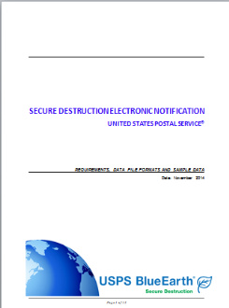
Receiving electronic notifications is a Two Part Process*
Notification of new address or reason for non-delivery is provided to mailer via ACS™
Secure Destruction Data is associated with the IMb™ and will be provided in a separate report
* All mailer SD eNotification records will be provided daily in reports available to registered mailers through the customer Electronic Product Fulfillment (EPF) customer portal website
Notes:
Acs people get their move files, then you get a 2nd file for secure destruction

Slide 22

Secure Destruction eNotifications Data File Record
Facility ID
(i.e. CIOSS Plant Zip)
SD File
Mailer ID
Mailer IMbTM
Scan Date and Time

Slide 23

NEXT STEPS
Increase your awareness of the new SD mail service option and how it works
Make the decision to enroll
Target the 1st Class mailings that would benefit most from the service
Enroll in the SD Program via our National Customer Support Center
Prepare Mailings with SD STIDs
Start saving Money !!
Next Steps
Review SD documents and materials available on RIBBS
Reach out to us with any questions
Share this presentation with key stakeholders in your organization
Discuss SD benefits and obtain buy in from senior management

Slide 24

NEXT STEPS
For Additional Information on Secure Destruction visit the RIBBS SD Webpage at https://ribbs/index.cfm?page=securedestruction
SD Enrollment and eNotification Questions?... Contact the National Customer Support Center at:
Phone: 877-640-0724, option 1
Email: acs@usps.gov
Other SD Questions? …Contact the USPS
Office of Sustainability SD Program Mgt. Team
Phone: 203-574-6590
Email: ronald.f.robbins@usps.gov
Questions?

Slide 25
