Slide 1
Northeast Area
Mailing Industry Focus Group
November 9, 2016
James A. Farley Building
New York, NY

Slide 2
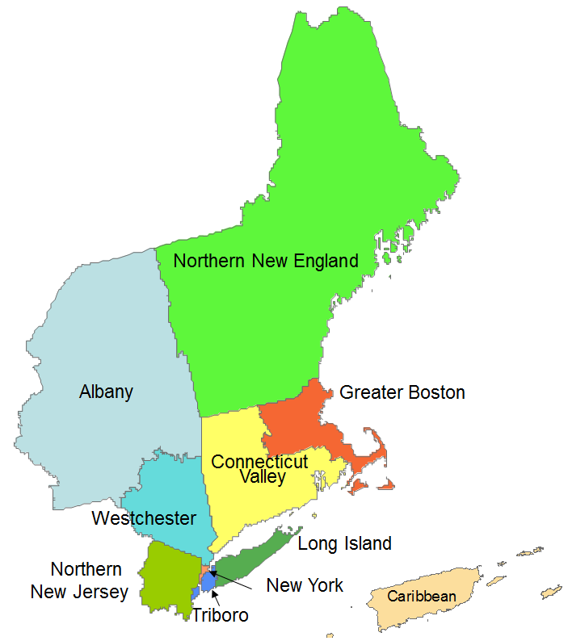
Northeast Area
Quarter 4, FY 2016
Performance

Slide 3
Northeast Area Quarter 4, FY 2016
First-Class Overnight
Target 96.80
100 -
90 -
80 -
70 -
60 -
50 -
% On-Time
94.96
94.92
FY 2016
FY 2015
July 1, 2016 – September 30, 2016

Slide 4
Northeast Area Quarter 4, FY 2016
First-Class 2 Day
Target 96.50
100 -
90 -
80 -
70 -
60 -
50 -
% On-Time
94.75
92.91
FY 2016
FY 2015
July 1, 2016 – September 30, 2016

Slide 5
Northeast Area Quarter 4, FY 2016
First-Class 3-5 Day
Target 95.25
100 -
90 -
80 -
70 -
60 -
50 -
% On-Time
91.88
86.61
FY 2016
FY 2015
July 1, 2016 – September 30, 2016

Slide 6
Northeast Area Quarter 4, FY 2016
Standard SCF
Target 91.00
100 -
90 -
80 -
70 -
60 -
50 -
% On-Time
94.73
90.82
85.93
80.74
FY 2016
FY 2015
FY 2016
FY 2015
Letters
Flats
July 1, 2016 – September 30, 2016

Slide 7
Northeast Area Quarter 4, FY 2016
Standard ndc
Target 91.00
100 -
90 -
80 -
70 -
60 -
50 -
% On-Time
90.68
87.88
85.24
83.49
FY 2016
FY 2015
FY 2016
FY 2015
Letters
Flats
July 1, 2016 – September 30, 2016

Slide 8
Northeast Area Quarter 2, FY 2016
Periodicals
Target 90.00
100 -
90 -
80 -
70 -
60 -
50 -
% On-Time
83.28
78.96
FY 2016
FY 2015
July 1, 2016 – September 30, 2016

Slide 9
Bundle Visibility Scores
FY 2015 vs. FY 2016
% of FS Nested Bundles Score 82.46% in Q4,FY 2016 that is 31.99% of increase from previous year
% of Load Score 48.94% in Q4, FY 16 that is 23.38% of increase from previous year

Slide 10
Bundle Visibility Scores
FY 2015 vs. FY 2016
Greater Boston District score 90.42% in Q4, FY 16 that is 51.27% increased fro previous year.

Slide 11
Bundle Visibility Scores
FY 2015 vs. FY 2016

Slide 12
Priority Improvement
Effective Monday October 3, 2016
Mid-Hudson (124-127) Originating and Destinating Priority to Greater Newark P&DC on 10/3
Stamford (066, 068, 069) Originating and Destinating Priority to NJ NDC on 10/3
Effective Monday October 31, 2016
New York (100-102, 104) Destinating Priority to NJ NDC.
Queens (110, 111, 113, 114) Destinating Priority to Bethpage P&DC
Long Island (115, 117-119) Destinating Priority to Bethpage P&DC

Slide 13
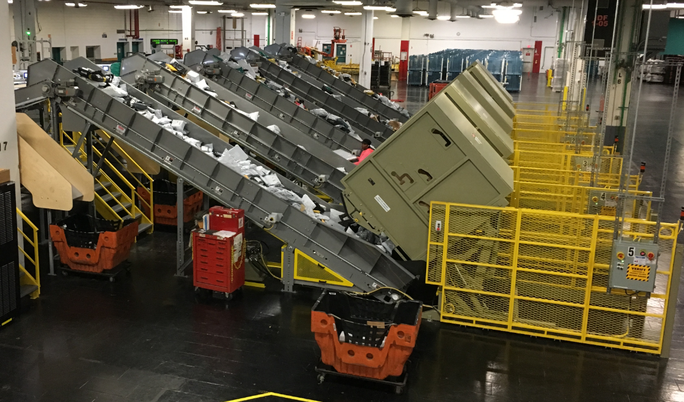
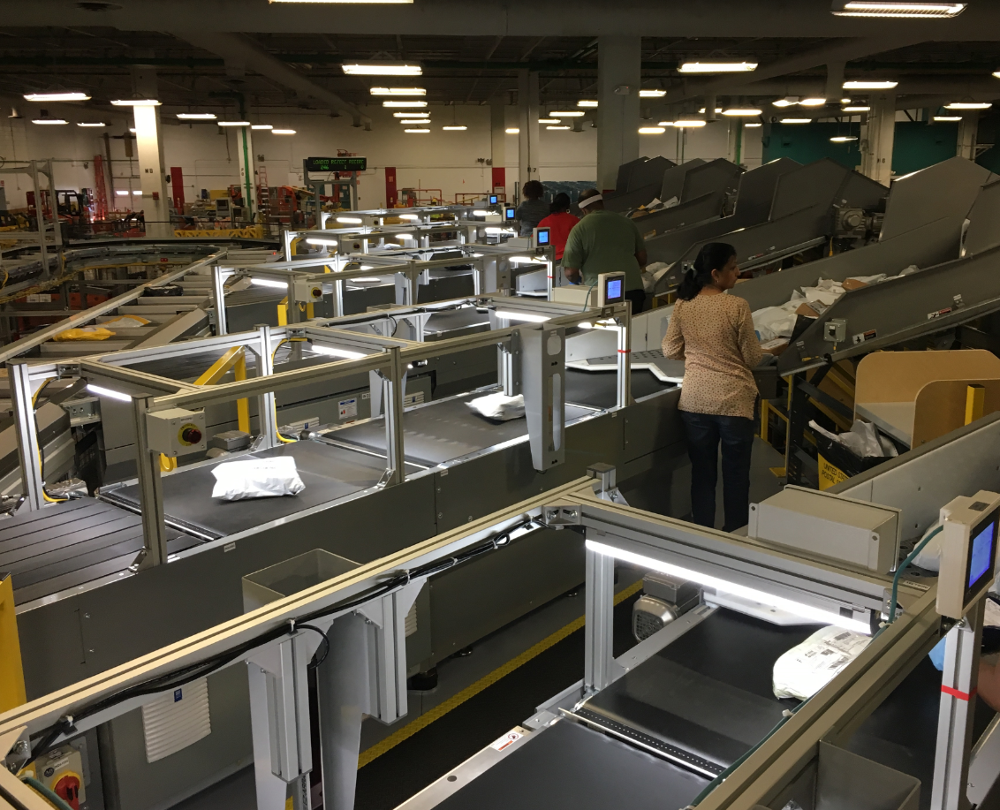
New SPSS in Stamford
Stamford P&DC has been repurposed with 2 new Small Package Sorting Systems.
Facility will process Import IPP from
JFK / New York ISC

Slide 14
National Surface Visibility Expansion

Slide 15
LAU (Phase 1) - Program Highlights
Letter Automation Upgrades:
Phase 1
Area Update - October 24, 2016

Slide 16
The Finer Points of LAU-Phase 1
LAU Phase 1 addresses critical end-of-life issues with the Postal Service’s letter automation equipment and is an integral part of infrastructure for the PMG’s Informed Delivery initiative
Key benefits for the WFOV - LAU-PH1 include:
Phase I consists of replacing the Wide Field of View (WFOV) computer system and the image collection board. Deployment will consist of approximately 5,000 units deployed to 250 sites
Initiates activities to preserve the reliability, quality, and efficiency of the Postal Service’s letter automation equipment
Renews parts availability for spares and repairs
Establishes capacity for future PC and video processor enhancements
Provides common PC for barcode reading position on all DBCS-Phase 2-6, CIOSS, DIOSS & LCREM machines

Slide 17
LAU (Phase 1) – Deployment
1st Phase of Deployment (~1000 units on 11/28/16)
Area | Site_Name | Op_Qty | Installs Per/Week | Installs Per/Day
CAPITALMETRO | Richmond P&DC (Pre-BETA) | 8 | 2 | 1
CAPITALMETRO | Richmond P&DC (BETA & FAT) | 25 | 6 | 1
Area | DeploymentName | Op_Qty | Installs Per/Week | Installs Per/Day
SOUTHERN | North Houston P&DC | 69 | 17 | 2
SOUTHERN | North Texas P&DC | 43 | 11 | 2
SOUTHERN | Fort Worth P&DC | 36 | 9 | 2
SOUTHERN | Dallas P&DC | 24 | 6 | 1
SOUTHERN | Beaumont P&DF | 8 | 2 | 1
SOUTHERN | Houston North DDC | 5 | 1 | 1
EASTERN | Philadelphia P&DC | 56 | 14 | 2
EASTERN | Pittsburgh P&DC | 51 | 13 | 2
EASTERN | South Jersey P&DC | 30 | 8 | 1
EASTERN | Trenton P&DC | 26 | 7 | 1
EASTERN | Delaware P&DC | 23 | 6 | 1
Area | DeploymentName | Op_Qty | Installs Per/Week | Installs Per/Day
PACIFIC | Los Angeles P&DC | 74 | 19 | 3
PACIFIC | Santa Clarita P&DC | 59 | 15 | 3
PACIFIC | Santa Ana P&DC | 54 | 14 | 2
PACIFIC | Oakland P&DC | 51 | 13 | 2
PACIFIC | Margaret Sellers P&DC (BETA) | 41 | 10 | 2
PACIFIC | San Jose P&DC | 31 | 8 | 2
PACIFIC | San Francisco P&DC | 29 | 7 | 2
PACIFIC | San Bernardino P&DC | 27 | 7 | 1
PACIFIC | Santa Barbara P&DC | 23 | 6 | 1
PACIFIC | Anaheim P&DF | 17 | 4 | 1
PACIFIC | North Bay P&DC | 17 | 4 | 1
PACIFIC | Moreno Valley DDC | 16 | 4 | 1
GREAT LAKES | Cardiss Collins P&DC | 55 | 14 | 2
GREAT LAKES | Carol Stream P&DC | 30 | 8 | 1
NORTHEAST | Dominick V Daniels P&DC | 62 | 16 | 3
NORTHEAST | North New Jersey Metro P&DC | 23 | 6 | 1
NOTE-1: For the first deployment phase there will not be any units sent to the Western Area
NOTE-2: **ACTION** - A full site list will be sent to you for verification of site Name, Address, POC & Phone # needs to be returned no later than this Friday the 28th

Slide 18
LAU (Phase 1) - Program Process
LAU-Phase 1
Deployment site list has been prioritized and validated by Informed Delivery PMO
LAU/WFOV installation will be completed by USPS Site Maintenance
LAN/MICS (Mail Image Capture System) install dates for LAU sites have started and will be completed prior to arrival of LAU/WFOV Computers
Check LAU Deployment Schedule on ETHOS for details
WFOV PCs will arrive to sites via FedEx freight

Slide 19
LAU (Phase 1) - Next Steps
✓
ETHOS Training for Richmond/S. Diego – October 24
In-Plant Testing at MTSC – October 7, 2016
Pre-BETA – October 17-21
First Article Test – (Richmond) – November 7
Phase 2 Deploy – January 4 – March 16, 2017
BETA 1 at Richmond P&DC – October 31 - November 11
ETHOS Training for Phase 1 Deployment – October 28
BETA 2 at ML Sellers P&DC – November 07-18
First Article Testing – November 07-18
Phase 1 Deploy – (~1000 units) – November 28
✓
✓
✓
Notes:
19

Slide 20
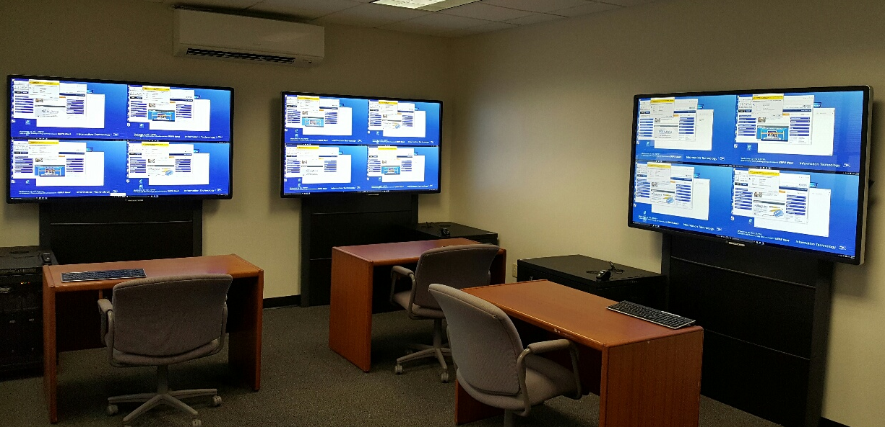
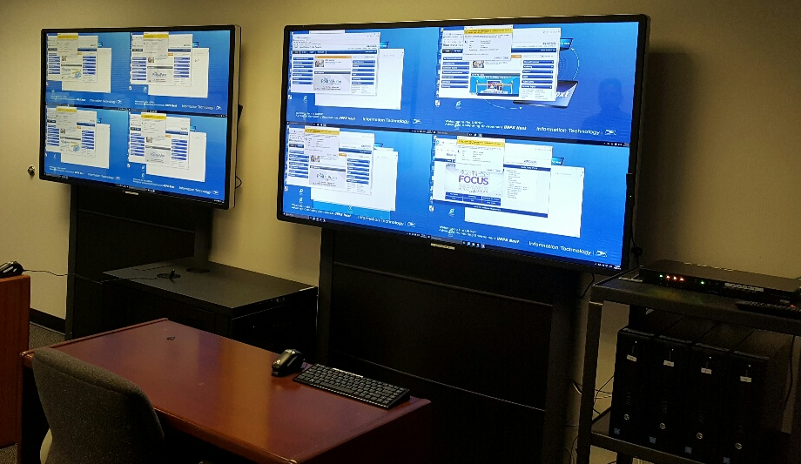
Network Operations Command Center
“NOCC”
Network Operations Command Center Overview
Real-time monitoring:
Mail Processing – Projected Workload vs Actual
Maintenance indicators
Surface Visibility Containers
Surface transportation trailer tracking
THS operations build and break operations
Air transportation potential rollover and overflow

Slide 21
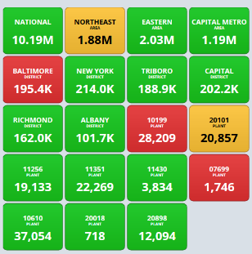
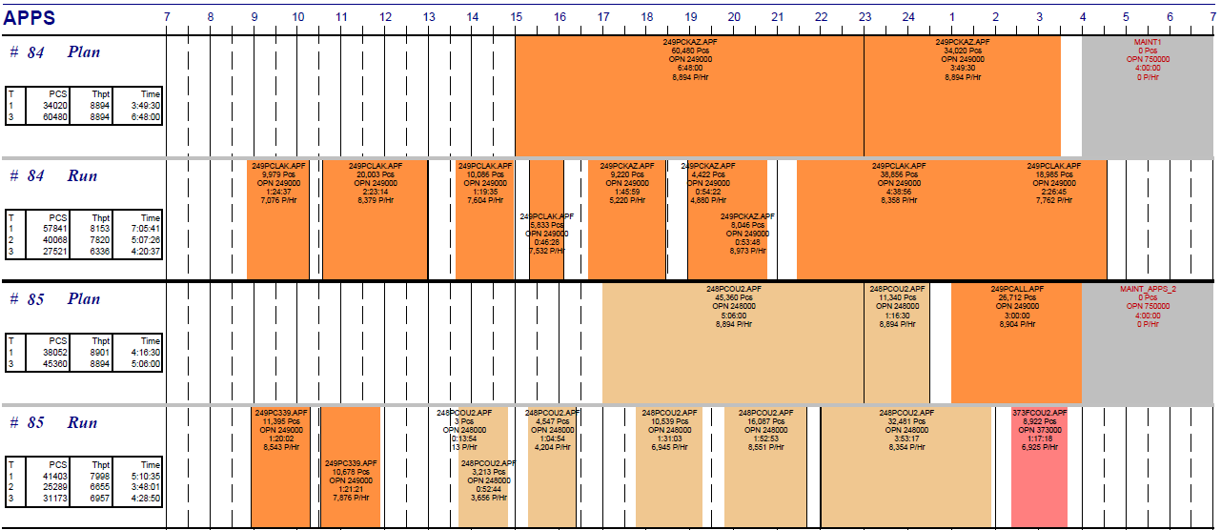
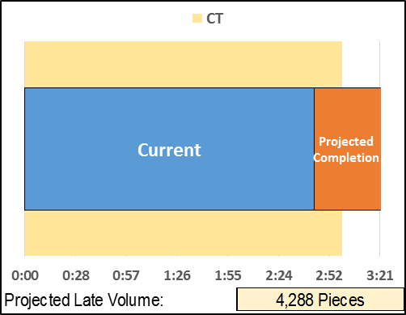
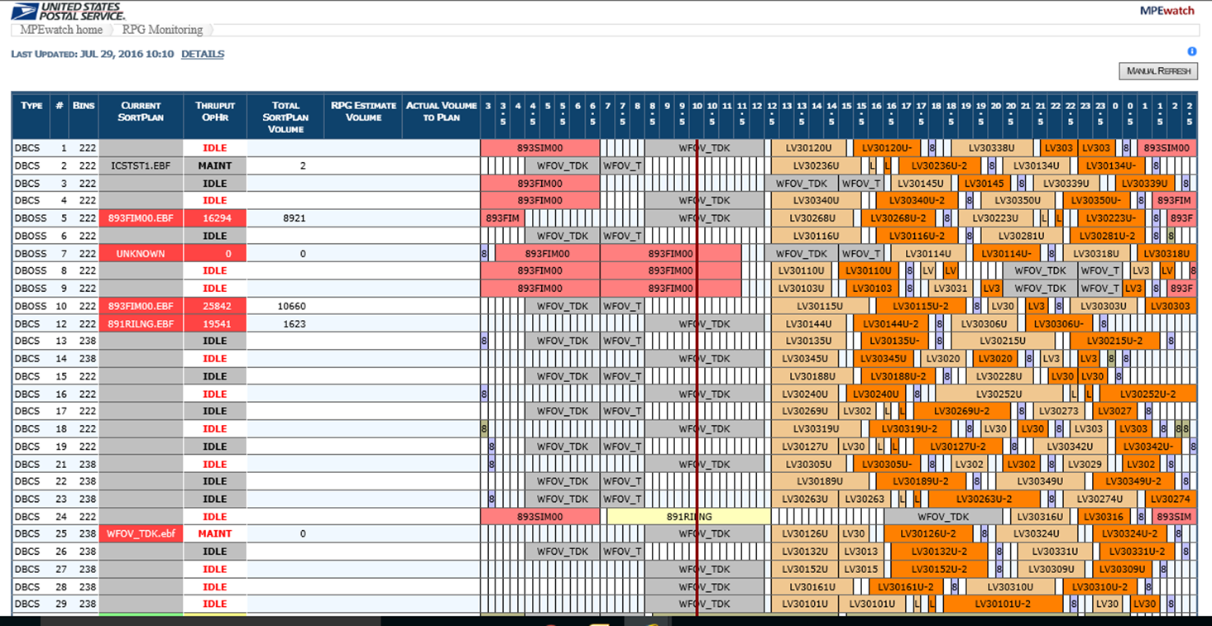
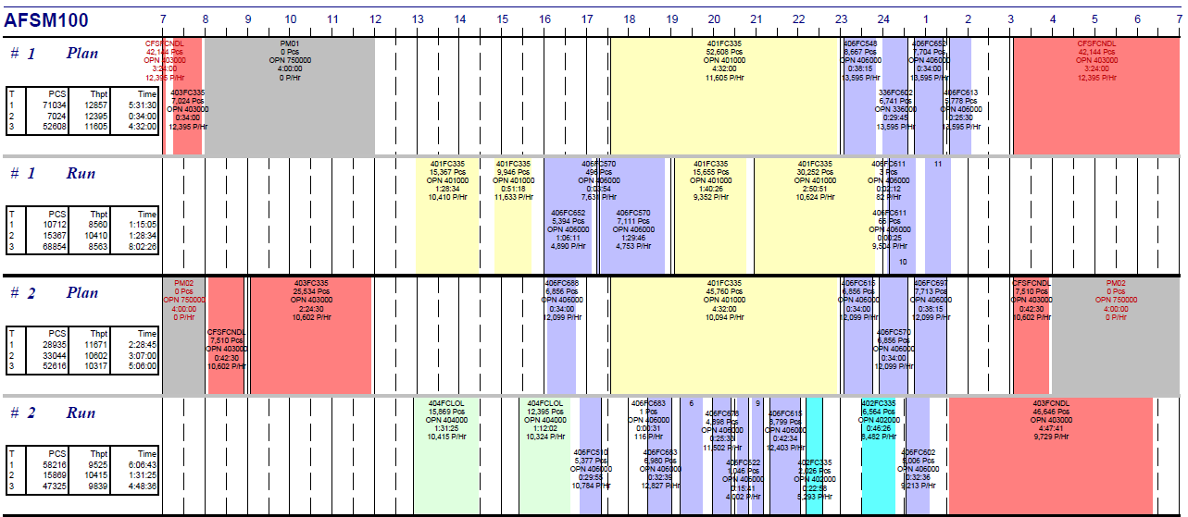
Network Operations Command Center
Processing Operations
Package Machine Workload to Plan
Package Machine Est. Completion / Delayed
Main screen identifies critical facilities
Drillable to facility / machine details
Main screen identifies critical facilities
Drillable to facility / machine details
Report identifies faculties / machines that are not meeting planned operations, i.e. throughput, run hours, and connectivity
Identifies PSS scanner details
Updates on 15 minute intervals
Report identifies faculties / machines that will not meet cut off time based on volume projections and current runtime
Updates on 15 minute intervals
Data Source(s): MPE Watch / EOR
Data Source(s): MPE Watch / EOR
Letters Workload to Plan / Est. Completion
Flats Workload to Plan / Est. Completion
Main screen identifies critical facilities
Drillable to details facility / machine
Main screen identifies critical facilities
Drillable to facility / machine details
Report identifies faculties / machines that are not meeting planned operations, i.e. throughput, run hours, and connectivity
Updates on 15 minute intervals
Report identifies faculties / machines that are not meeting planned operations, i.e. throughput, run hours, and connectivity
Updates on 15 minute intervals
Data Source(s): MPE Watch / EOR
Data Source(s): MPE Watch / EOR

Slide 22
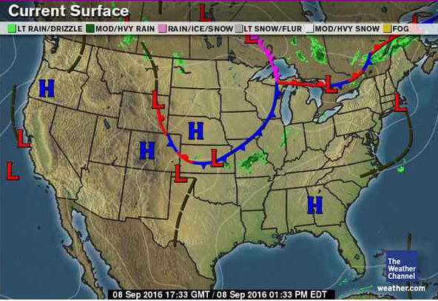
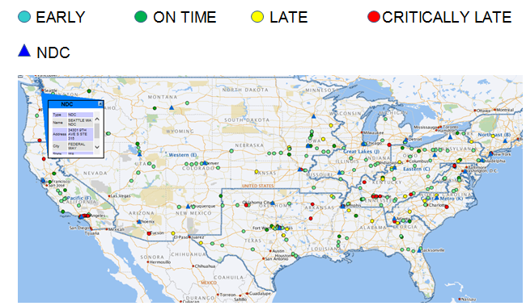
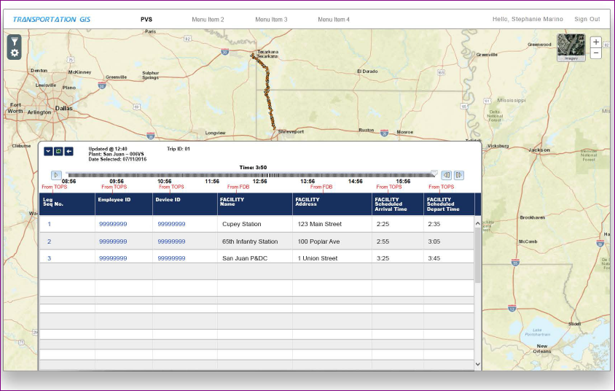
Network Operations Command Center
Surface Transportation
Weather
HCR Tracking
Data Source(s): weather.com
Data Source(s): https://networks/HomepageWeb/
PVS Tracking
Trailer Utilization
Letters
Under Development
Data Source(s): Transportation GIS (under development)
Data Source(s): Transportation GIS (under development

Slide 23
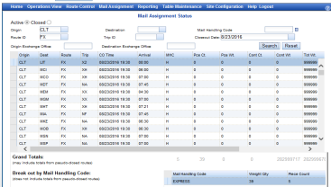
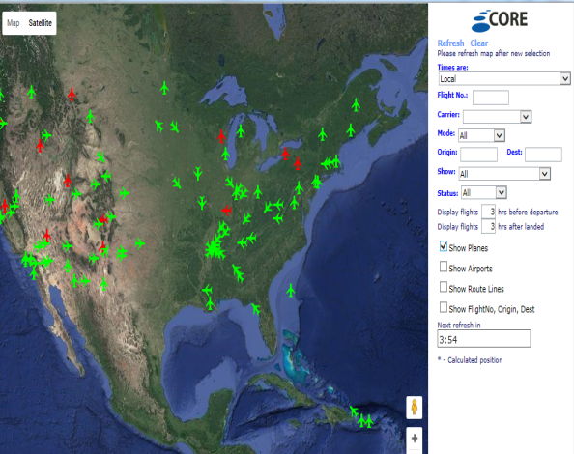
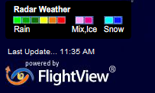
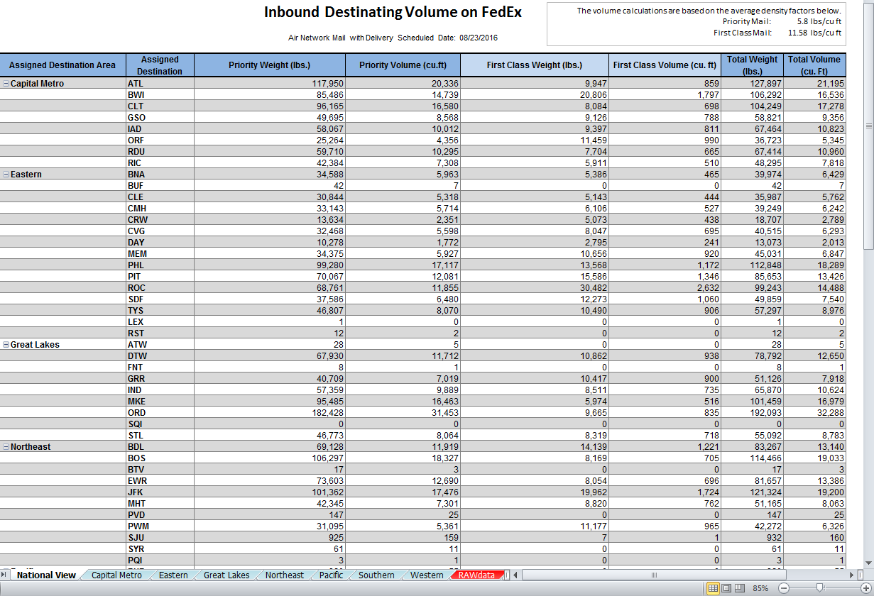
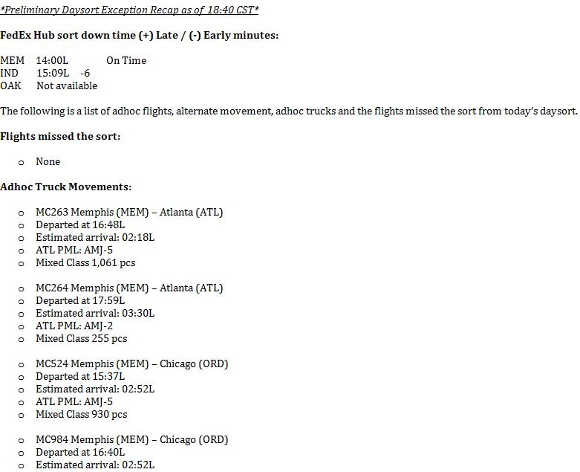
Network Operations Command Center
Air Network
Originating Assign Network Build
Flight Tracker/Weather
Main screen identifies critical facilities
Drillable to THS HUBs
F
Report Fed Ex flights for delays or cancellations as well as on time.
Updates on 15 minute intervals
Data Source(s):
Sams Web
Data Source(s): CORE
l
Destinating Volume Break
Adhoc Moves
The data is generated from PTM ops
Data Source(s): National Operations Center

Slide 24
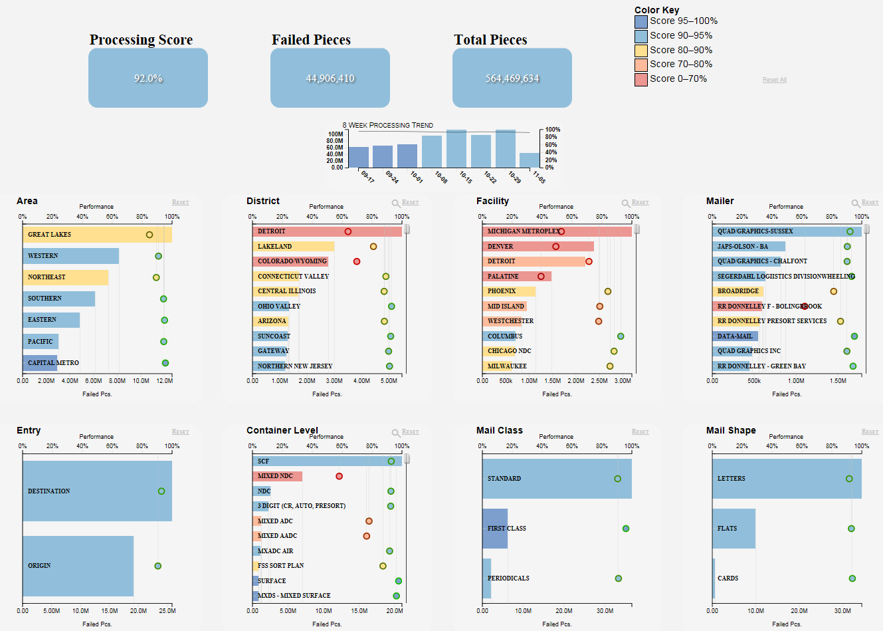
Enterprise Analytics
New Service Performance Processing Visualization

Slide 25
Enterprise Analytics
New Service Performance Processing Visualization
Provides Diagnostics Based on Originating or Destinating
Area
District
Facilty

Slide 26
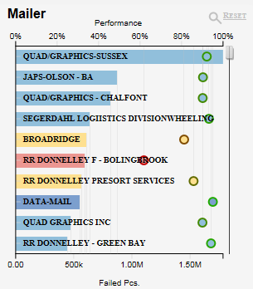
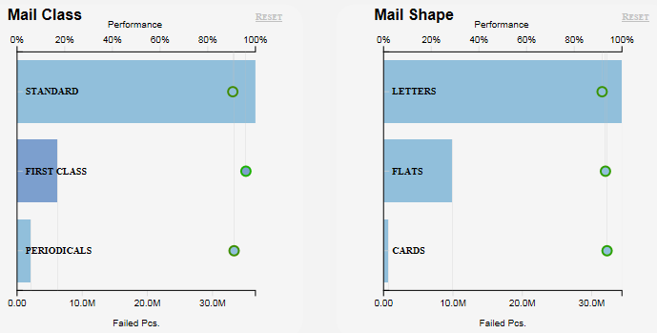
Enterprise Analytics
New Service Performance Processing Visualization
Provides Diagnostics Based on
Mailer
Mail Class
Mail Shape

